Slide 1
Statistical
Distribution Fitting
Dr. Jason Merrick
Notes:
Last update August 20, 1998

Slide 2
Some Issues in Fitting Input Distributions
Not an exact science — no “right” answer
Consider physical or logical process that generates the data
Consider range of distribution
  Infinite both ways (e.g., normal)
  Positive (e.g., exponential, gamma)
  Bounded (e.g., beta, uniform)
Consider ease of parameter manipulation to affect means, variances - decision variables
Outliers, multimodal data
  Maybe split data set (see textbook for details)
  Consider theoretical vs. empirical

Slide 3
Eyeballing
One way to see if a sample of data fits a distribution is to
  draw a frequency histogram
  estimate the parameters of the possible distribution
  draw the probability density function
  see if the two shapes are similar
frequency
data values

Slide 4


Chi-Squared Test
Formalizes this notion of distribution fit
  O_{i} represents the number of observed data values in the i-th interval.
  p_{i} is the probability of a data value falling in the i-th interval under the hypothesized distribution.
  So we would expect to observe E_{i} = np_{i}, if we have n observations
frequency
data values
pdf
data values

Slide 5
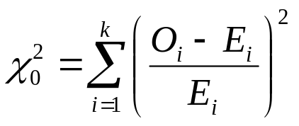
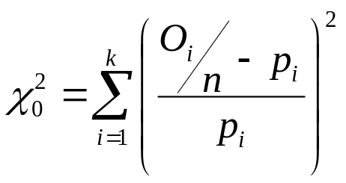
Chi-Squared Test
So the chi-squared statistic is
By assuming that the O_{i} - E_{i} terms are normally distributed,
  it can be shown that the distribution of the statistic is approximately chi-squared with k-s-1 degrees of freedom
  s is the number of parameters of the distribution
Hint: consider

Slide 6
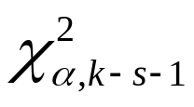
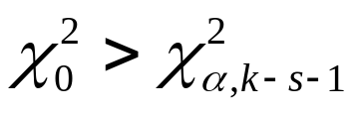
Chi-Squared Test
So the hypotheses are
  H₀: the random variable, X, conforms to the distributional assumption with parameters given by the parameter estimates.
  H₁: the random variable does not conform.
The critical value is then , which is also the 100α%-quantile of a gamma distribution with scale 1/2 and shape (k-s-1)/2.
  Reject if
This gives a test with significance level α.
  But what about the power of the test?

Slide 7
Chi-Squared Test
If the expected frequencies E_{i} are too small, then the test statistic will not reflect the departure of the observed from the expected frequencies.
  The test can reject because of noise
  In practice a minimum of E_{i} ≥ 5 is used
  If E_{i} is too small for a given interval, then adjacent intervals can be combined
For discrete distributions
  each possible discrete value can be a class interval
  combine adjacent values if the E_{i}’s are too small

Slide 8


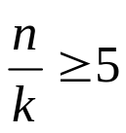
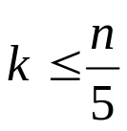
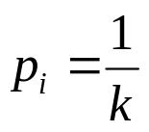
Chi-Squared Test
For continuous data
  intervals that give equal probabilities should be used, not equal length intervals
  this gives a better power for the test
    the power of test is the probability of rejecting a false hypothesis
  it is not known what probability gives the highest power, but we want

Slide 9
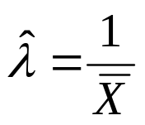


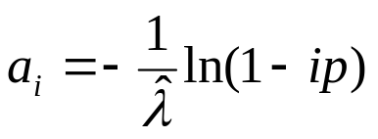
Chi-Squared Test
Example: the exponential distribution
  Suppose that we have n observations, possibly exponential
  We estimate that using the data
  So we must use k ≤ 10 intervals, so we choose 8 to get p = 0.125
  To find the endpoints of the i-th interval, [a_{i-1},a_{i})
⇒
⇒

Slide 10
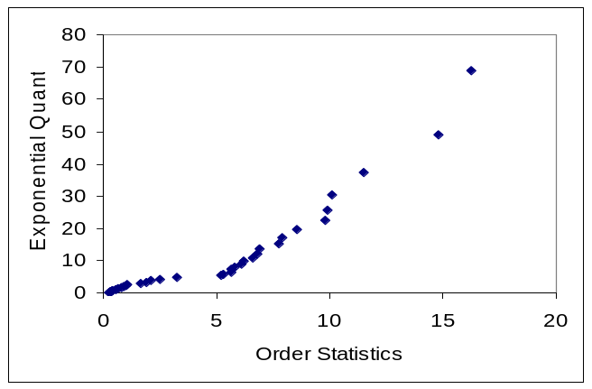
Eyeballing
Another method of seeing if a distribution fits sample data is the q-q plot
  x is the q-quantile of a random variable X with cdf F if F(x)=q or x=F⁻¹(q)
  Take a data sample {x₁,…x_{n}} and order them to get y₁ ≤ y₂ ≤ ... ≤ y_{n}
  y_{j} is an estimate of the (j - 0.5)/n quantile
  Plot y_{j} versus F⁻¹((j - 0.5)/n )
  This should give a straight line

Slide 11
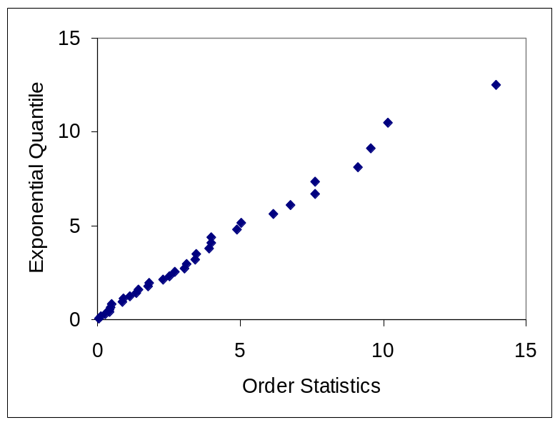
Eyeballing
Note:
  Will never actually be a straight line
  Order statistics are not independent
  One point above line will likely be followed by another
  The variance at the extremes is larger
  So for exponential, you will likely see more discrepancy at larger values

Slide 12
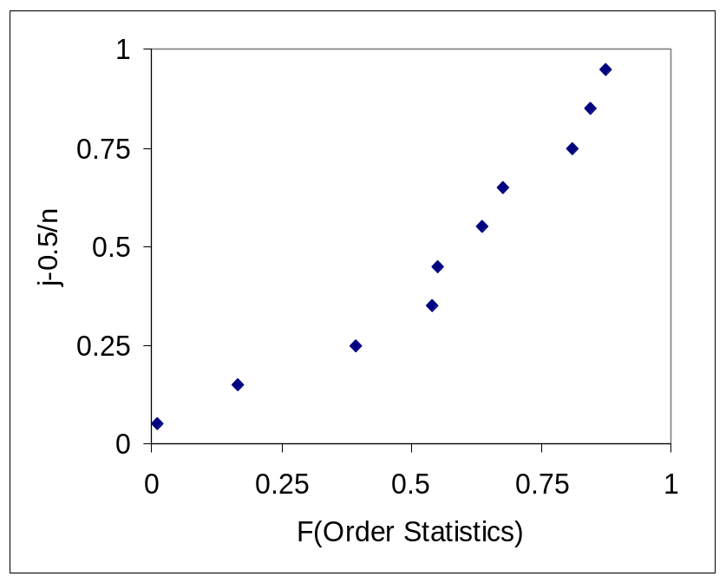
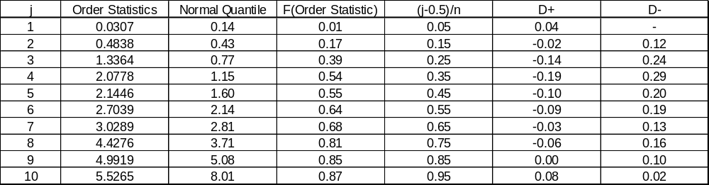
Kolomogorov-Smirnov Test
Formalizes the idea of a q-q plot
  The scales are changed by applying the CDF to each axis
  D⁺ = max_{j} {(j - 0.5)/n ) - F(y_{j})}
  D⁻ = max_{j} {F(y_{j}) - (j - 1 - 0.5)/n )}
  Note that there are no D⁺‘s for some observations
  The test statistic is given by D = max{D⁺, D⁻}

Slide 13
Comparing the Two Tests
The Chi-Squared Test
  Not just a maximum deviation, but a sum of squared deviations
  Uses more of the information in the data
  So it needs more data to be accurate
  Is more accurate if it has enough data
The Kolmogorov-Smirnov Test
  Just a maximum deviation
  Needs less data to be accurate
  Is less accurate with more data

Slide 14
Empirical Distribution
“Fit” Empirical distribution (continuous or discrete): Fit/Empirical
  Can interpret results as a Discrete or Continuous distribution
    Discrete: get pairs (Cumulative Probability, Value)
    Continuous: Arena will linearly interpolate within the data range according to these pairs (so you can never generate values outside the range, which might be good or bad)
  Empirical distribution can be used when “theoretical” distributions fit poorly, or intentionally
  When sampling from the empirical distribution, you are just re-sampling from the data

Slide 15
No Data?
Happens more often than you’d like
No good solution; some (bad) options:
  Interview “experts”
    Min, Max: Uniform
    Avg., % error or absolute error: Uniform
    Min, Mode, Max: Triangular
      Mode can be different from Mean — allows asymmetry
  Interarrivals - independent, stationary
    Exponential - still need some value for mean
  Number of “random” events in an interval: Poisson
  Sum of independent “pieces”: normal
  Product of independent “pieces”: lognormal

Slide 16
Multivariate and Correlated Input Data
Usually we assume that all generated random observations across a simulation are independent (though from possibly different distributions)
Sometimes this isn’t true:
  If a clerk starts to get long jobs, they may get tired and slow down
  A “difficult” part requires long processing in both the Prep and Sealer operations
Ignoring such relations can invalidate model

Slide 17
Checking for Auto-Correlation
Suppose we have a series of inter-arrival times
  What is the relationship between the j-th observation and the (j-1)st?
  What is the relationship between the j-th observation and the (j-2)nd?
We are talking about auto-correlation as the series is correlated with itself
How many steps back we are looking is called the lag

Slide 18
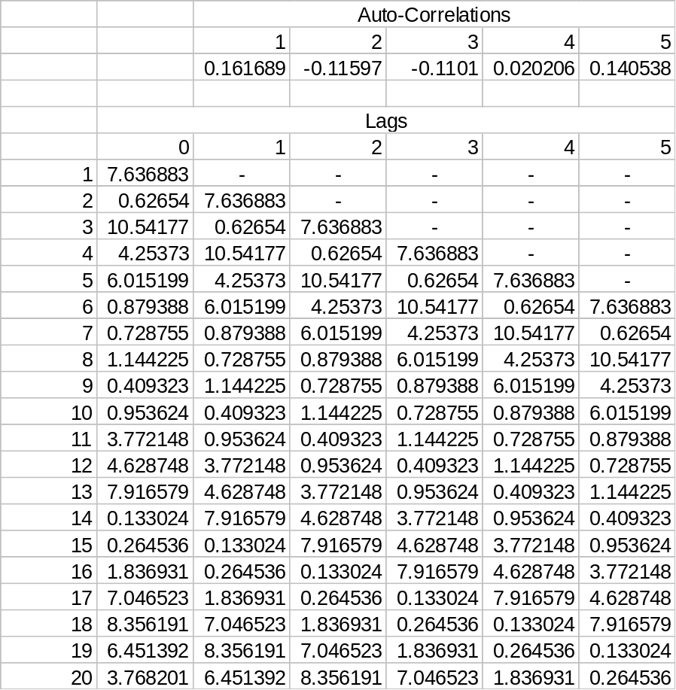
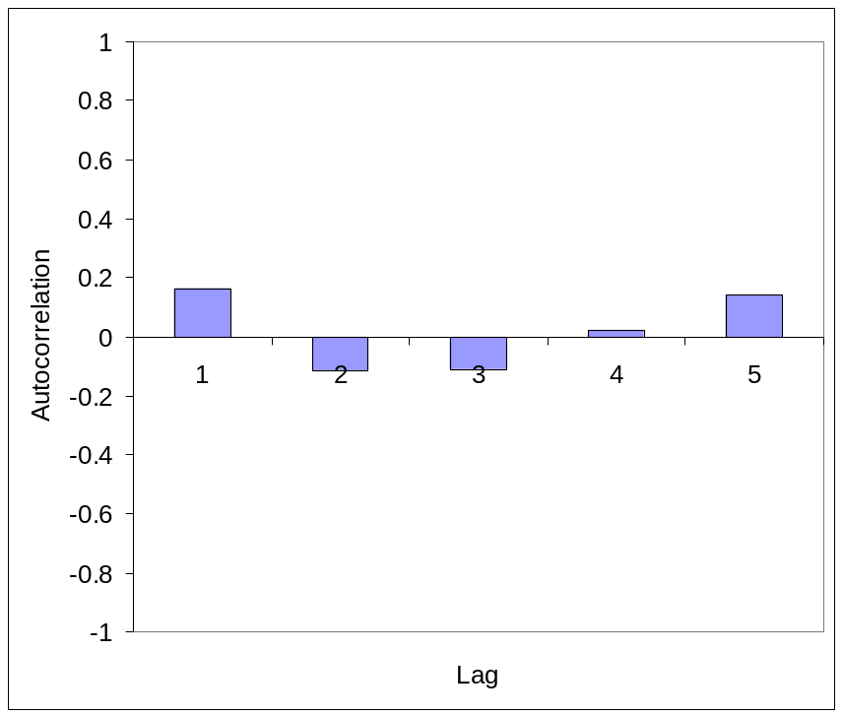

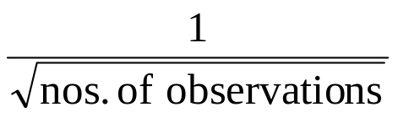
Auto-Correlation
Standard deviation of auto-correlation
estimate is

Slide 19
Time Series Models
If the auto-correlation calculations show a correlation, then you may have to use a time-series model
Such models are auto-regression models and moving average models
Using the auto-correlation and another concept called the partial auto-correlation, you can fit these models
The details are too much for this course

Slide 20
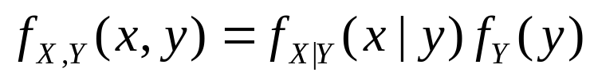
Multivariate Input Data
A “difficult” part requires long processing in both the Prep and Sealer operations
  The service times at the Prep and Sealer areas would be correlated
  Some multivariate models are quite easy, for instance the multivariate normal model
  You can also use the multiplication rule, to specify the marginal distribution of one time and then specify the other time conditional on the first time

